Slide 1
Partner 5 & 9 presentation
Initial Conference in Livorno
Name of Presenters
Partner 9: City of Bystřice - Michaela Kaprálková and Kateřina Adamová
Partner 5: DEX Innovation Centre - Vojtěch Jíra
28 JUNE 2023 | 15 Minutes | Livorno Province HQ – Council Hall

Slide 2
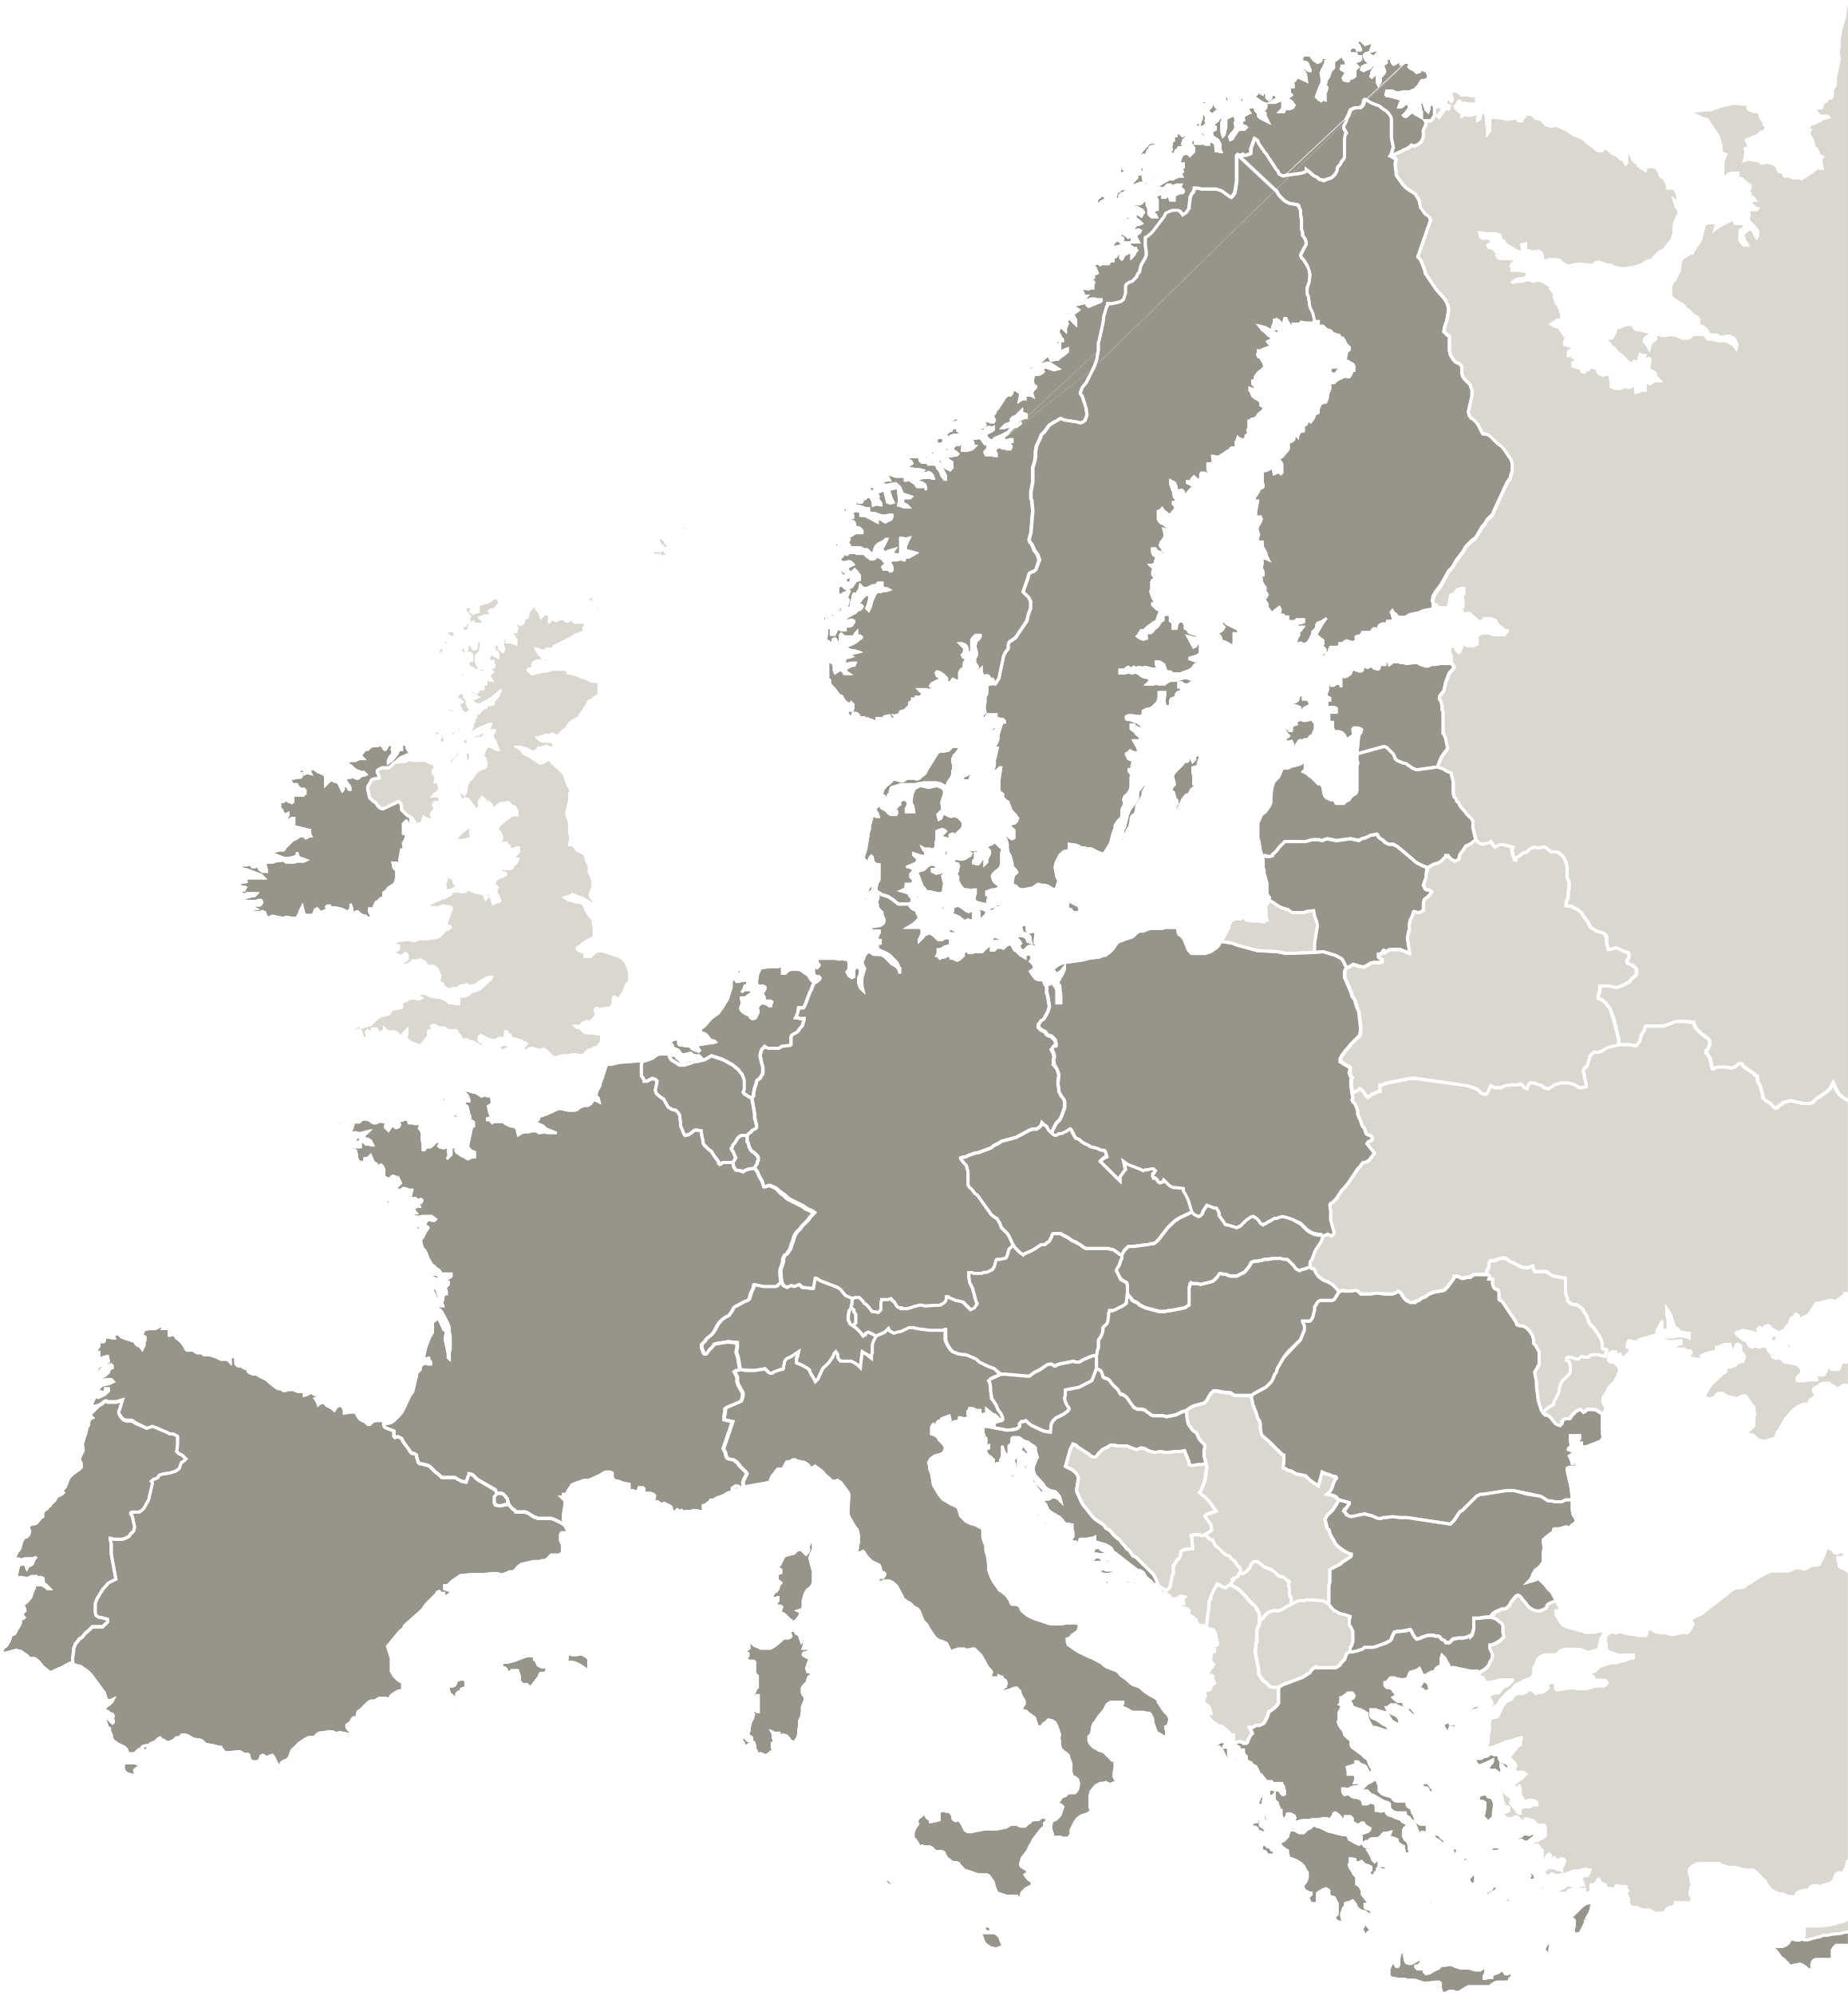
City of Bystřice
Maybe small in size but big in ideas, accepting challenges and open minded with highly-motivated and enthusiastic team.
City motto “#nadobreceste“
DEX Innovation Centre
City of Bystřice
Czech Republic
10
partners
CITY 1
CITY 1
CITY 1
Sintra
Murcia
Livorno

Slide 3
City of Bystřice
The involment in Interreg Programmes:
„RuALL“ Danube Region Program – Liveable Rural Communities of the Future - New Integrated governance model to address depopulation of rular areas
„BeCreative-BeSustainable“ CENTRAL EUROPE 2021-2027– Boosting Creative and Sustainable Jobs in Rural Areas
„PERPETUAL DANUBE“ Danube Region Program – Valorization and raising of visibility of cultural & natural heritage asset
„SOFTOUR“ Danube Region Program – joint Sustainable develOpment oF smaller cities in rural or remote areas of the Danube region through a community-led TOURism model

Slide 4
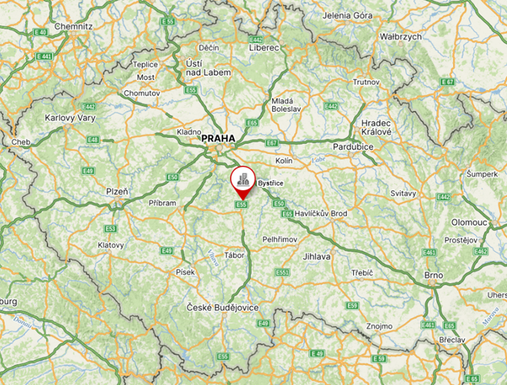
Territorial context
City of Bystřice
located in Central Bohemia within easy driving distance of the capital
air quality influenced by the industrial character of the region and density of traffic
quite a large area of 65 sq km with low density of population and large number of commuters increase the use of individual transport
TOTAL

Slide 5
Partner policy
The Development Strategy of Bystřice city 2020 – 2030
Sustainable Energy and Climate Action Plan
Local Energy Concept
Covenant of Mayors – Europe
Healthy Cities, Towns and Regions of the Czech Republic

Slide 6
Partner stakeholders
Czechinvest – Business and Investment Development Agency
Centre for Transport and Energy – a non-profit non-governmental organisation
Public Mobility Department – Central Bohemian Region
Czech Technical University in Prague – Faculty of Electrical Engineering
E-ON – electricity supplier
BENEBUS – Local Transport Provider
Local Action Group Posázaví

Slide 7
Our goals
connected and well accesible city - functional transport and the connection of the city with the surrounding settlements/backbone infrastructure
support of non-motorized transport - reducing the impact of transport on the surrounding environment
modern transport infrastructure - adoption of good practices, new points of view and new approaches to energy efficiency and sustainable mobility
energy self-sufficiency of the city, renewable resources, support for electromobility
creation and implementation of strategic documents and methodology
maintaining currrent commitments
(Healthy Cities, Towns and Regions of the Czech Republic, Covenant of Mayors –
Europe)

Slide 8
Barriers and drivers
12.3 MEUR

Slide 9
Thank you!
Name of Presenters
City of Bystřice
Michaela Kaprálková
michaela.kapralkova@mestobystrice.cz
Kateřina Adamová
Katerina.adamova@mestobystrice.cz
katerina.adamova@mestobystrice.cz
DEX Innovation Centre
Vojtěch Jíra
Vojtech.jira@dex-ic.com
www.interregeurope.eu/PROMOTER

